Slide 1

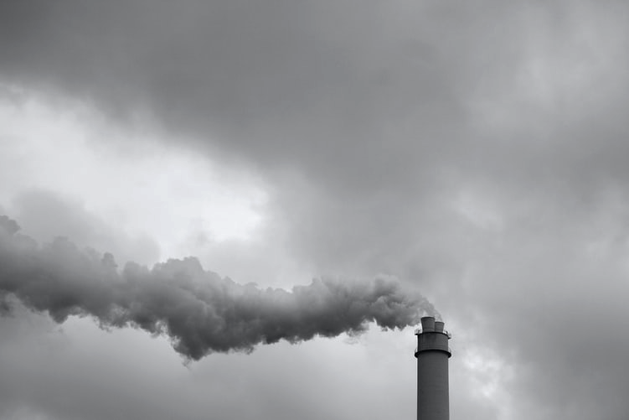

Team:
Vasantha Mutyala
Valense Acquah-Louis
Aarvin Rathod
Duncan Plate
Hazardous Air Pollutants (HAP)
A Summary of Daily Levels From 1990 to 2017.
What are Hazardous Air Pollutants?
HAP are a subcategory of Air Pollutants found in the atmosphere that are a detriment to the well being of living environment.
Effects of HAP
HAP are known or suspected to cause serious medical afflictions, such as cancer, compromised reproductive health, and birth defects.
Sources
These pollutants are emitted from factories, gasoline, heavy duty cleaning products and paint strippers.

Slide 2
Our Analysis
Classification of our analysis
Data is grouped into two HAP categories
Carbon-Based and Non-Carbon.
Project Description
Analyze the HAP data from 1990 to 2017 to produce informative conclusions about the causes.
At the conclusion of our analysis, we would have answered some questions we had and explored some interesting trends.

Slide 3
Questions we asked!
Which counties have the highest and lowest HAP?
What are the best and worst counties for carbon and non-carbon HAPs in CA?
What is the most prominent HAP?
What populations were at risk?

Slide 4
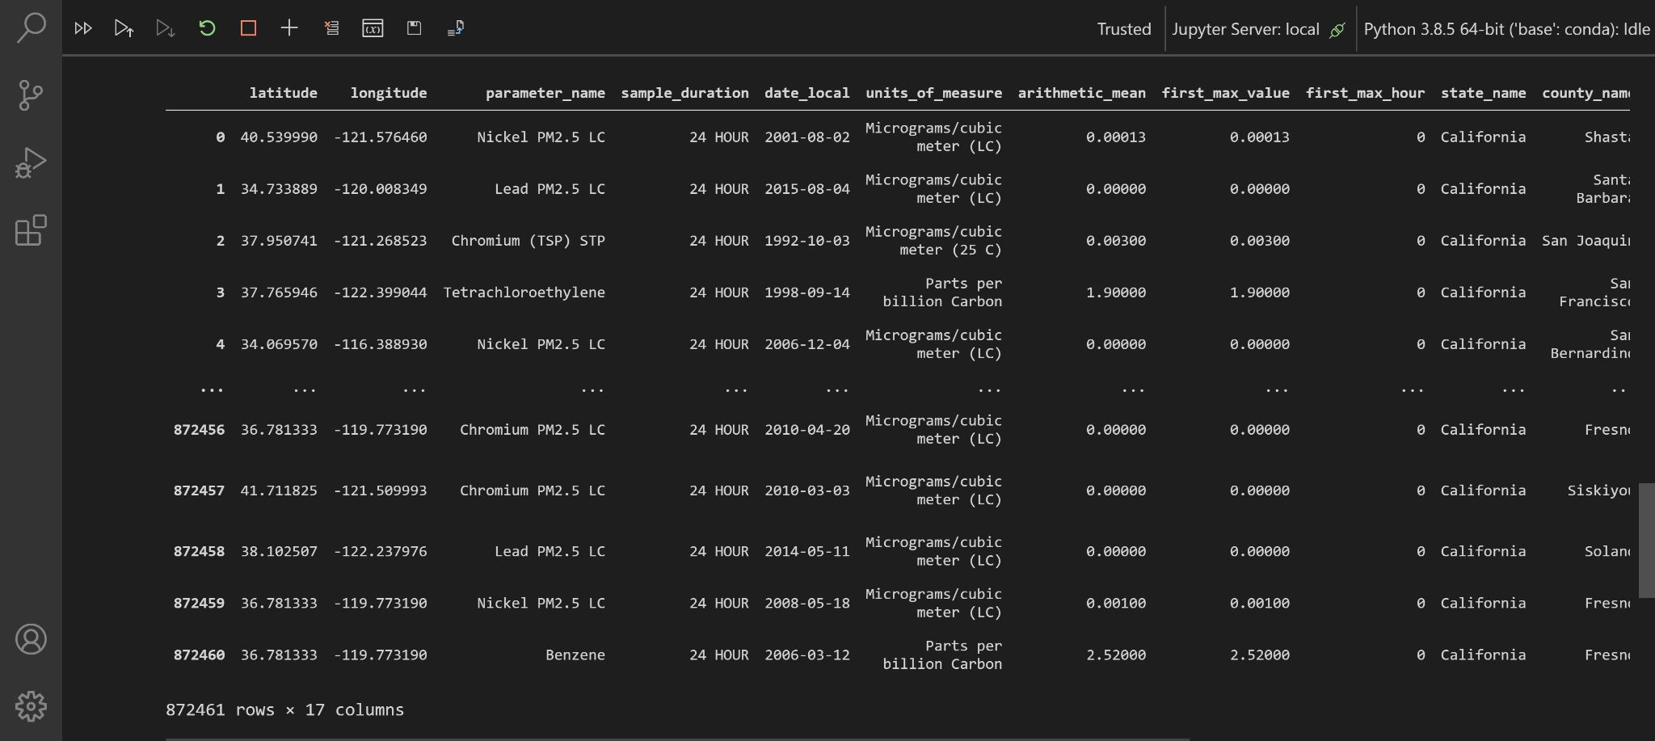
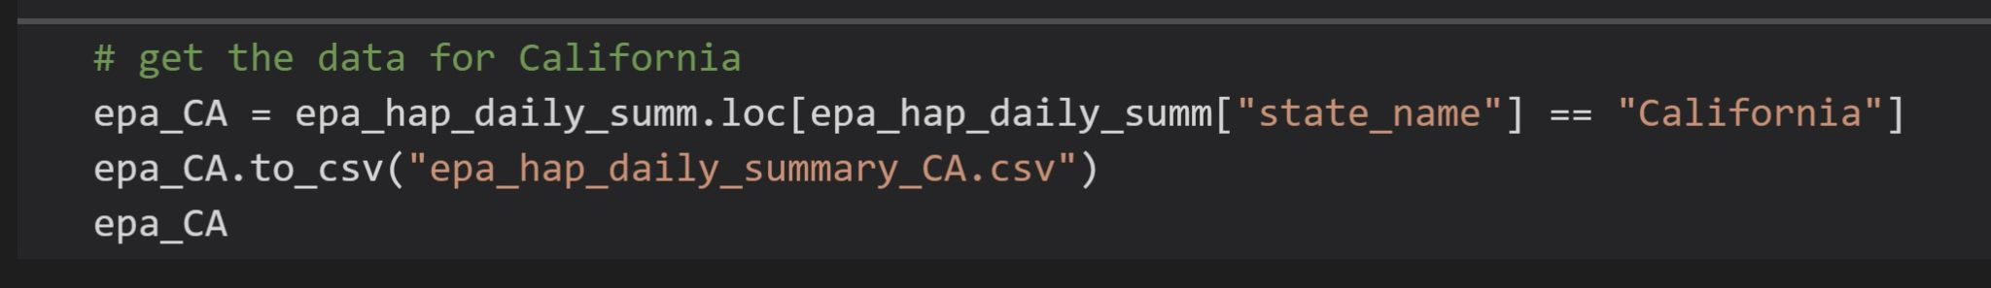
Cleaning
Data Sourced from : Kaggle
Size of Original Dataset: 8 million+
Total Columns : 29
After studying the data , we decided to do our Analysis to study the HAP for the state of California .
Narrowed down the list of fields, checked for NaN, dropped the rows that did not have relevant information that was required for our analysis. We added a few additional columns.
Size of the final dataframe 872461
Final DataFrame view
Amplify

Slide 5
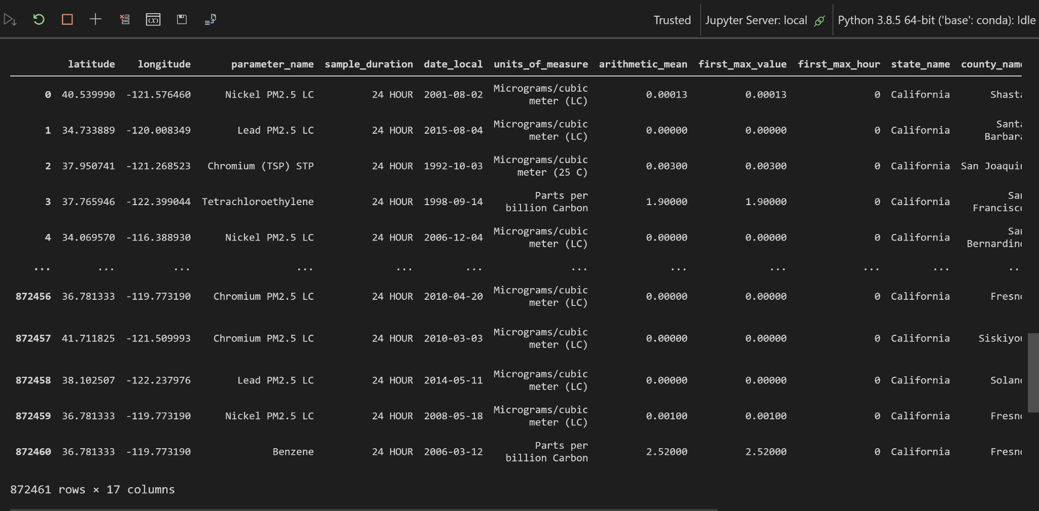
-

Slide 6
Cleaning
Data Sourced from : Kaggle
Size of Original Dataset: 8 million+
Total Columns : 29
After studying the data , we decided to do our Analysis to study the HAP for the state of California .
Narrowed down the list of fields, checked for NaN, dropped the rows that did not have relevant information that was required for our analysis. We added a few additional columns.
Size of the final dataframe 872461
Final DataFrame view
Amplify

Slide 7
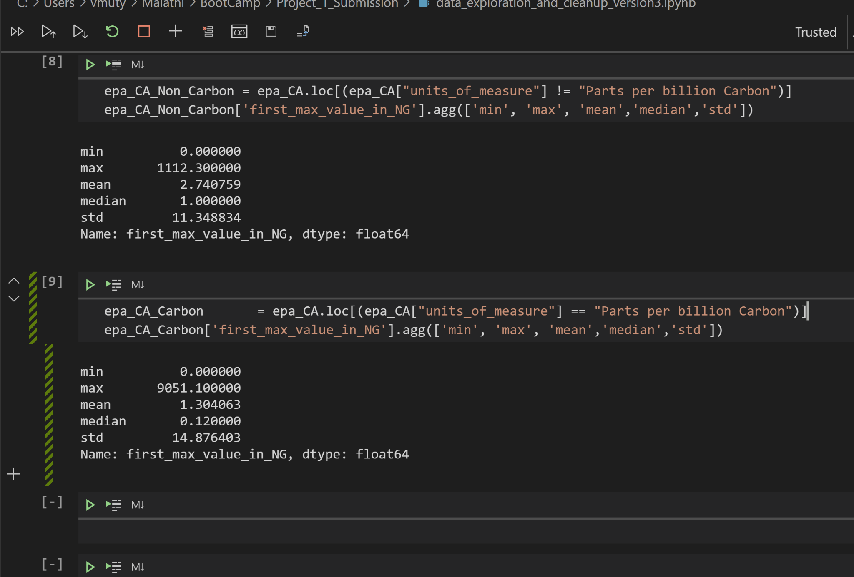
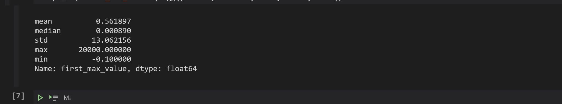
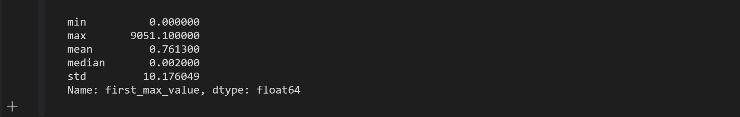
479734
Summary Statistics
Original Dataset
New Dataset

Slide 8

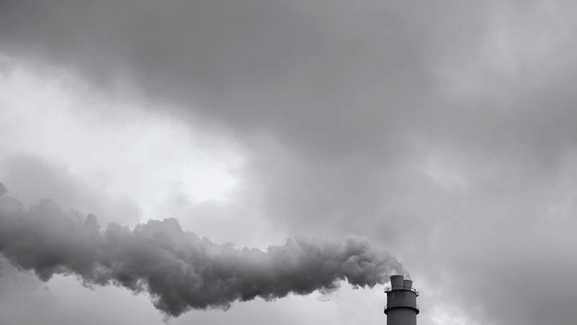

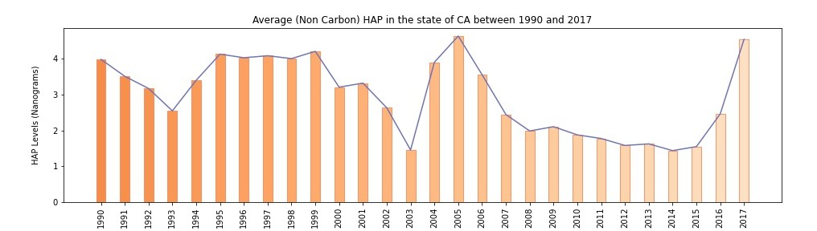
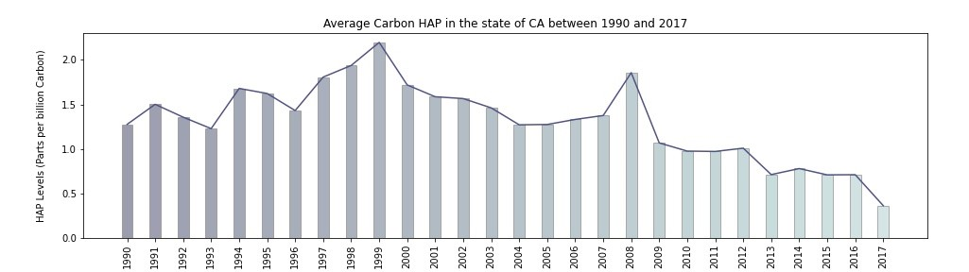
Non Carbon based HAP levels in California for the period of 1990 and 2017.
Carbon based HAP levels in California for the period of 1990 and 2017.
Wondering why there was a spike in 2005 for Non Carbon and 1999 for Carbon. What contributed to the spike? Let's find out.

Slide 9
Non Carbon based HAP levels in California for the period of 1990 and 2017.
The HAP levels have been declining. We see periods of spike with 2005 being highest.
2003 seems to be the year where HAP levels were at the lowest.
Carbon based HAP levels in California for the period of 1990 and 2017.
Carbon levels were at the peak in 1999 and the next highest was in 2008. Since then, it has been consistently declining. California's effort in mitigating the Carbon production seems effective.
Wondering why there was a spike in 1999 for Carbon and 2005 for Non-Carbon HAP.
What contributed to the spike? Let's find out. The next few slides are to analyze data for select years between 1990 and 2017 to get an insight about Highs and Lows.

Slide 10
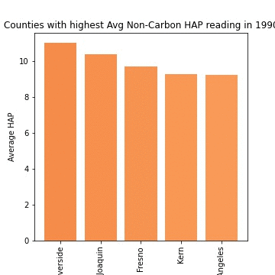
Top five Counties with High Non-Carbon HAP
2004 to 2006 orange county had a spike of almost 40 NG non carbon pollutants every year. It dropped to around 15 NG’s in 2007. Mean for Non-Carbon HAP is 3.19
In 2008 county of San Joaquin had a spike of around 25 NG of non-carbon HAP..
Since 2009 most of the top carbon counties have an average of around 7NG of Non-Carbon HAP.

Slide 11
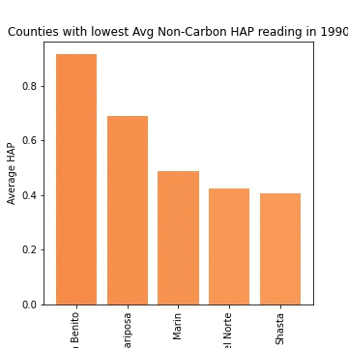
Top five Counties with Low Non-Carbon HAP
1990-2016 best non-carbon polluting counties had a average of less than 1. Mean being 3.19.
2017 had a spike in Non-carbon HAP with the bottom 5 jumping back closer to the mean.
2007-2016 county of Marin was in the bottom 5..

Slide 12
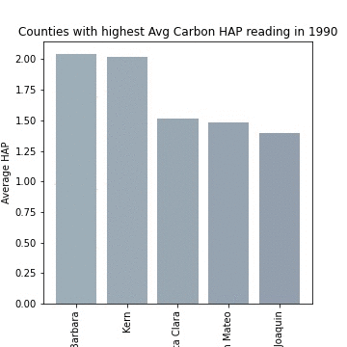
Top five Counties with High Carbon readings
In 2008 county of Sacramento had a reading of over 100 PPB Carbon when mean is 1.35.
since 2008 - barring Riverside in the 2016 and 2017 the highest Carbon HAP has been under the 3.
The bar graphs confirm a downward trend and showcase outliers being the issue for higher Carbon HAP’s.
Investigating the outliers and solving the underlying issues will help reduce the average Carbon levels even further

Slide 13
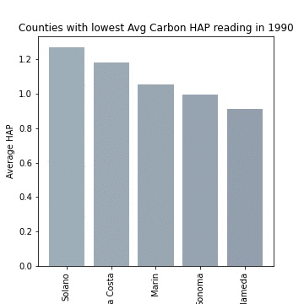
Top five Counties with Low Carbon readings
SInce 1993 bottom 5 have an average under than 1 PPB of carbon HAP and since 2000 bottom 5 have an average of under 0.5 PPB carbon HAP
Since 2008 lowest has been less than 0.3 PPB carbon HAP
Since 1994 county of Marin has been in the bottom 2 for carbon HAP confirming itself as the HAP champ in CA.

Slide 14
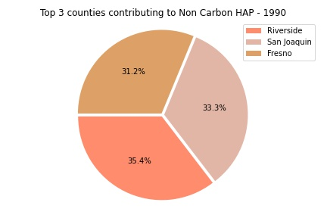
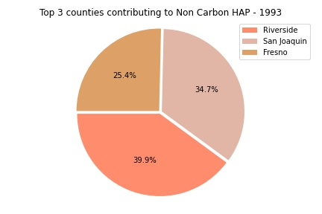
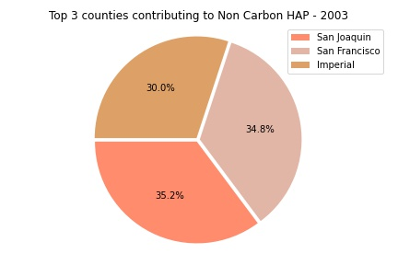
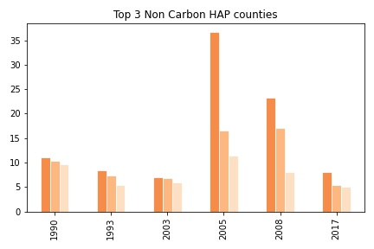
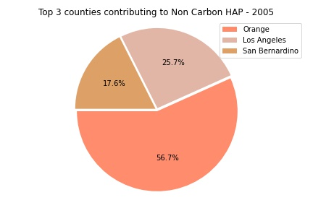
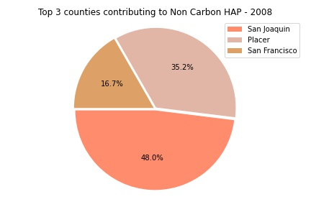
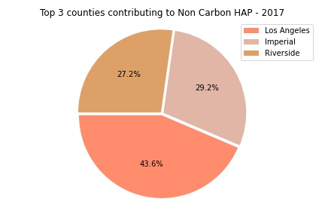

Slide 16
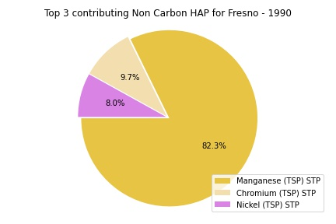
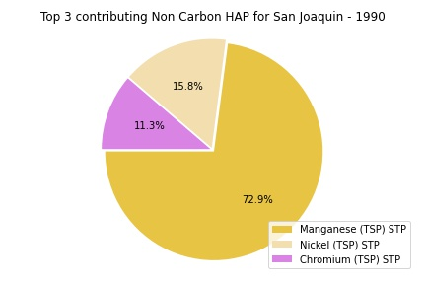
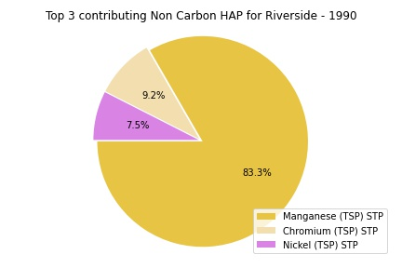
Explore more Non-Carbon
Move on to Carbon

Slide 17

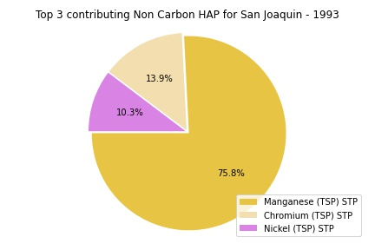

Explore more Non-Carbon
Move on to Carbon

Slide 18
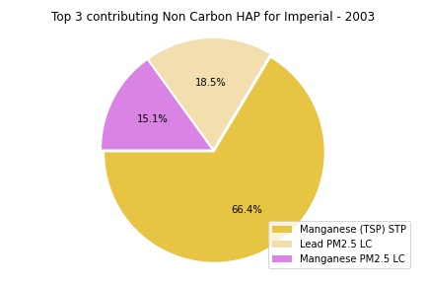
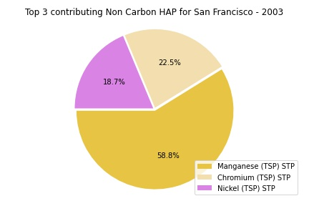
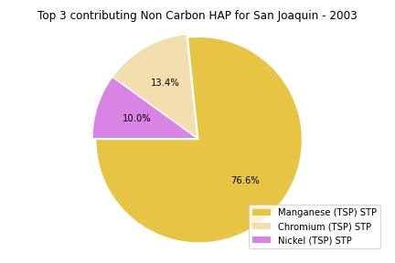
Explore more Non-Carbon
Move on to Carbon

Slide 19
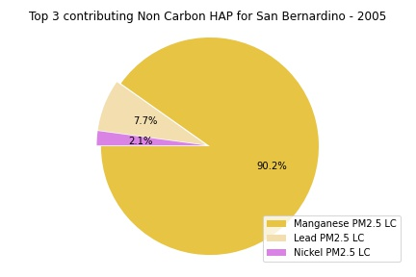
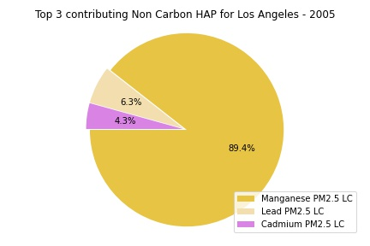
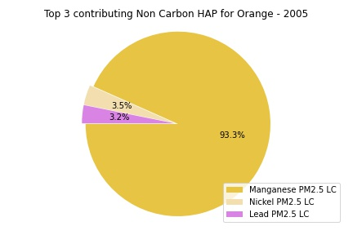
Explore more Non-Carbon
Move on to Carbon

Slide 20
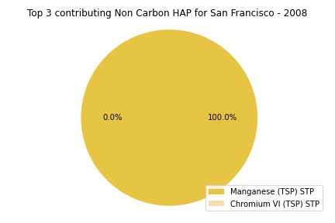
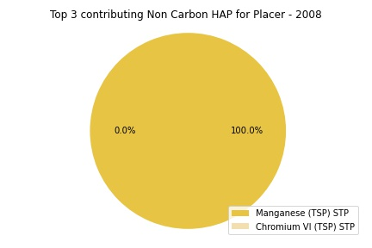

Explore more Non-Carbon
Move on to Carbon

Slide 21
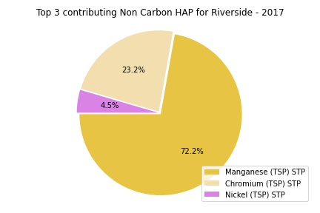
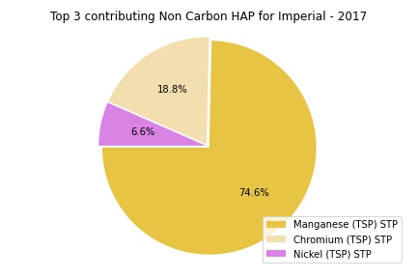
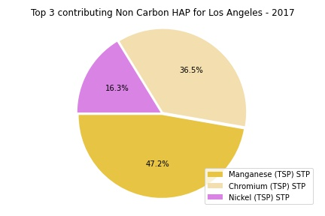
Explore more Non-Carbon
Move on to Carbon

Slide 22
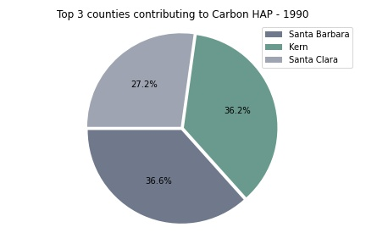
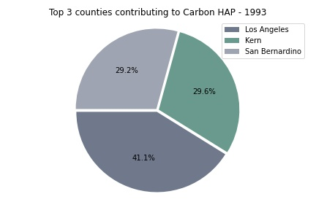
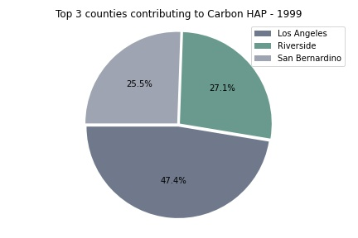
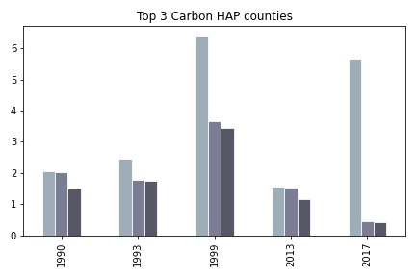
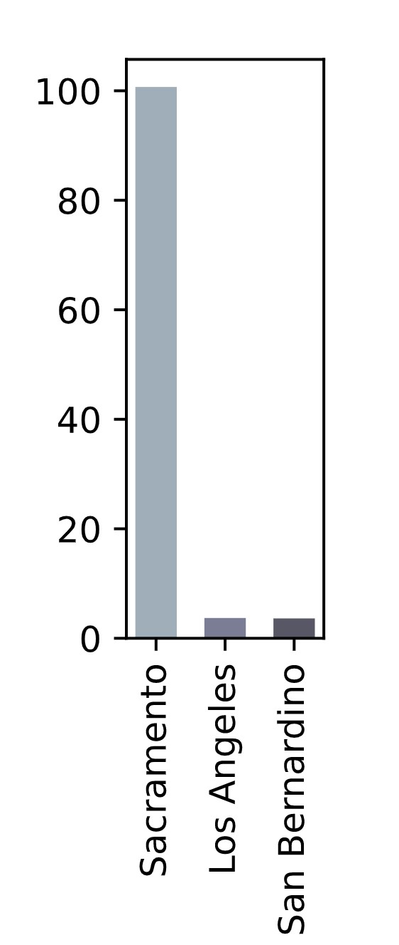
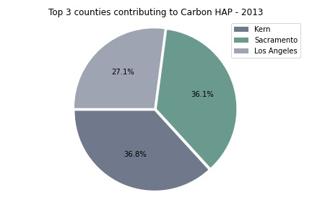
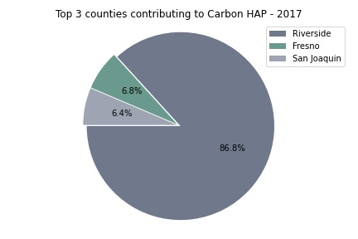
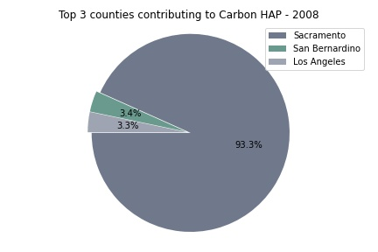
😟😵
😰
😳

Slide 23
😟😵
😰
😳

Slide 24
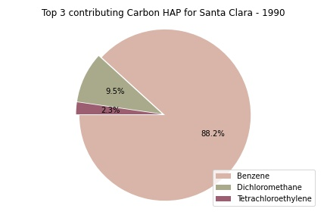
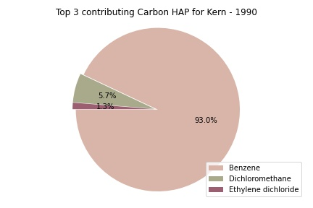
Explore more Carbon
Next

Slide 25
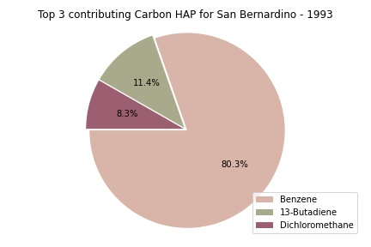
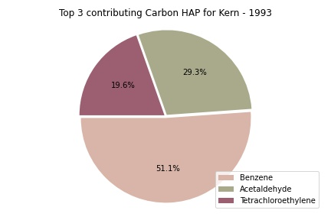
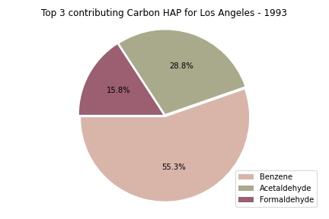
Explore more Carbon
Next

Slide 26
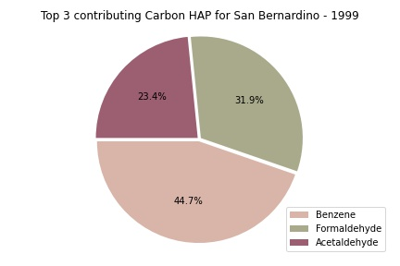


Explore more Carbon
Next

Slide 27



Explore more Carbon
Next

Slide 28



Explore more Carbon
Next

Slide 29



Explore more Carbon
Next

Slide 30


Example datasets of the generated Heatmaps:

Slide 31

Non-Carbon Hap Heatmap for 1990 to 2017

Slide 32

Carbon HAP Heatmaps 1990-2017

Slide 33
Thank you all!

